Slide 1
Protege Nos
Yiluo Li, Shaolin Zhang, Thomas Lee, Yong Mao

Slide 2
AI =

Slide 3
From where
A friend of mine is a volunteer for a disabled-student community, and we feel that lives of those with disabilities are not easy, so we intend to make a little contribution to the improvement of the lives of these underrepresented group.
did we get the idea

Slide 4
Technological Implementation

Slide 5
Ruff
Light Sensor
Confirm whether the current is night
LED
To remind others that there is a blind man here
Temperature & Humidity Sensor
Feedback real-time temperature and humidity
A JavaScript-based IoT Kit

Slide 6
Arduino
Tracking module
To detect whether or not the traveling route is offset
Avoid module
To detect obstacles
Gyro module
When the user falls, immediately send relevant information to the volunteer network
A C-powered Microprocessor with Optional Bluetooth Comm

Slide 7
Android
Image Recognition
Tell the blind what is in front of him/her
Weather
To get the real-time weather
Text-to-Speech
To increase accessibility for the disabled
A data-gathering and Networking Hub

Slide 8

Technological Difficulties

Slide 9
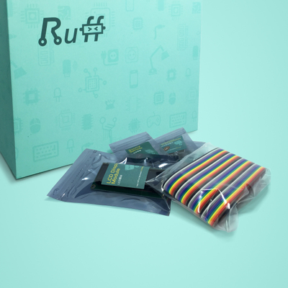
Ruff Hardware Driver Coding
One of the most difficult issues occurred was the lack of pre-existing hardware drivers for Ruff. To counter it, the team took effort in coding and implementing hardware drivers of various sensors including Avoidance Sensor and Tracking Sensor from scratch.
Ruff’s hardware driver is a JavaScript packaged version of its original, hardware layer C code.
Special thanks to Ruff and its support team.

Slide 10

Android Text-To-Speech
Text-To-Speech is one of the most common-used accessibility options for disabled people. For their convenience, this project incorporates Android Text-To-Speech.
We attempted to use Xunfei Cloud for networked TTS engine but its documentation is so unfriendly that we have to drop it.
We moved to use Android’s system Locale TTS Engine (Pico or Samsung as the two most common-seen).

Slide 11

Location-based Weather Service
The mobile application incorporates an online Weather API, OpenWeatherMap to retrieve current weather and forecasted weather.
To make the use of the app universal, the development take special account into determining the location of the user and provide weather information accordingly.

Slide 12
Features
Recognize image and give possible guess to elements in tag;
Retrieve user location and provide weather data accordingly;
Use Text-To-Speech to read out loud useful information on screen;
Alarm if there is any obstacle in front of the user;
Track whether the user is on track;
we accomplished during our 24-hour Penta Hackathon

Slide 13
Features
Gather environment data using Light & Temperature Sensor and act accordingly (LED signal);
Read data from Gyroscope Sensor to ensure a rapid response if the user accidentally falls;
Communication concept and verification between Arduino, Ruff and Android using both Wi-Fi and Bluetooth.
we accomplished during our 24-hour Penta Hackathon
(cont.)

Slide 14
Features
Realization of communication between subsystems;
Build a platform to connect this end-node system with a network of NGO, volunteer groups, community centers and related local governmental authorities;
UI optimization to make the app more user-friendly.
we intend to add after the hackathon

Slide 15
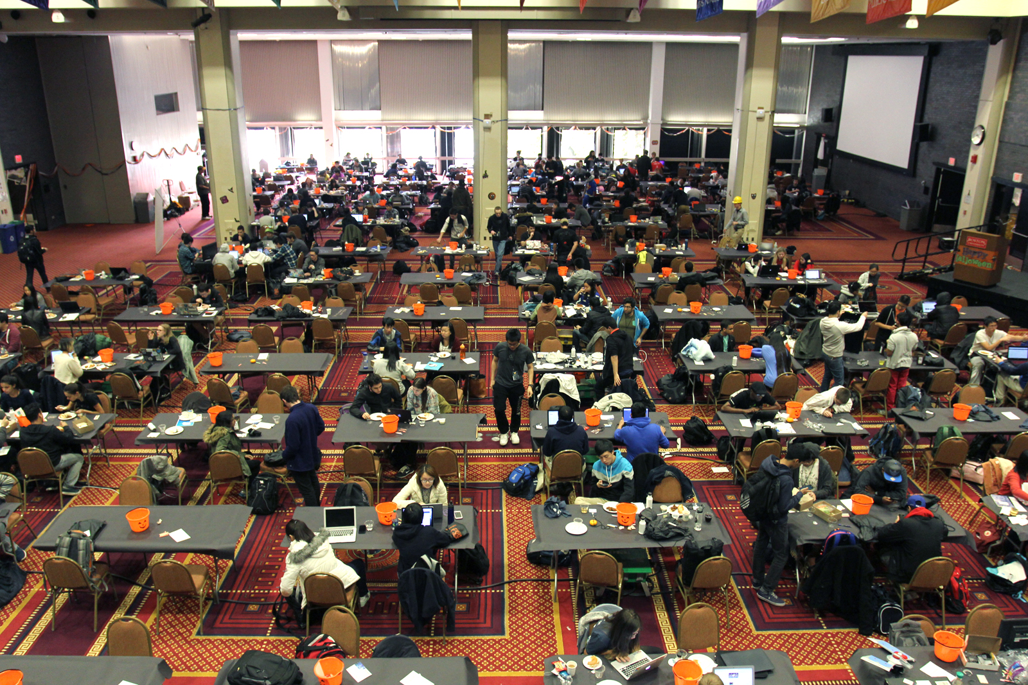
All lives matter. All lives deserve to be happy.

Slide 16

The only team with a millennium.

Slide 17
Thank you.

